Slide 1
Chap 3 Kinematics
Lim Wan Hong
2012

Slide 2
Learning outcomes
(a) Define displacement, speed, velocity and acceleration
(b) use graphical methods to represent displacement, speed, velocity and acceleration
(c) find displacement from the area under a velocity-time graph
(d) use the slope of a displacement-time graph to find the velocity
(e) use the slope of a velocity-time graph to find the acceleration

Slide 3
(a) Definitions : displacement, speed, velocity and acceleration
Distance – total path travelled of an object from the starting point to the finishing point.
Displacement – shortest distance travelled by an object along a straight line in a specific direction with respect to a reference point.
Speed – distance travelled per unit time
Velocity – the rate of change of displacement
Average speed – total distance travelled/ total time taken (include the time during which the object is at rest)
Average velocity – displacement / total time taken (include the time during which the object is at rest)
Acceleration – the rate of change of velocity

Slide 4
Distance vs. displacement
6 m
B
A
8 m
10 m
C
An object moves from A to B then to C.
The distance it travels is 6+8 = 14 m
Displacement from the starting point is 10 m.

Slide 5
Distance vs. displacement
B
4 m
A
12 m
Cliff
C
A mass is thrown up vertically and reaches the base of the cliff, i.e. C. Taking upwards as positive,
The distance it travels is 4+12 = 16 m
Displacement from the starting point, i.e. A, is -8 m.

Slide 6
Instantaneous Speed vs. velocity
Speed = change in distance travelled/ elapsed time
Velocity = change in displacement/ elapsed time
The instantaneous speed is the magnitude of the instantaneous velocity.
Velocity may have a negative sign if the change in displacement is negative ( i.e. object moves in the opposite direction) but its speed is always positive in values.

Slide 7
Average Speed vs. Average velocity
B
A mass is thrown up vertically and reaches the base of the cliff after 4 seconds. Determine for the whole motion,
The average speed is 16 /4 = 4 m s ⁻¹
The average velocity is (-)8 /4 = (-) 2 m s ⁻¹
-ve sign shows the mass is moving in the opposite direction (of course according to the chosen positive direction of the predefined frame).
4 m
A
12 m
Cliff
C

Slide 8
Speed vs. velocity
5 ms⁻¹
5 ms⁻¹
A mass is dropped. It hits the ground with 5 m s⁻¹ and rebounds with 5ms⁻¹ . Taking downwards as positive,
The change in speed is 0 m s ⁻¹
The magnitude of change in velocity is 10 m s ⁻¹

Slide 9
Acceleration
A mass is moving in a circle with a constant speed.
After completing a revolution,
the average speed is not zero but
the average velocity is zero.
Its instantaneous speed is constant
Its instantaneous velocity keeps changing as its direction is changing.
Thus, the mass is accelerating.
Acceleration = the change in velocity per unit time

Slide 10
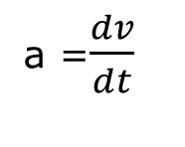
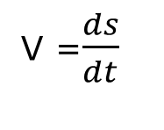
(b) Graphical Methods
(1) A mass is moving with a constant velocity
gradient
magnitude
s
v
a
t
t
t
V =$\frac{ds}{dt}$
a =$\frac{dv}{dt}$
gradient
magnitude

Slide 11
example
s
v
45 m
15 ms⁻¹
3
t
3
t/s
The displacement = 3 x 15 = 45 m from the starting point

Slide 12
Graphical Methods
(2) A mass is moving with a uniformly increasing velocity
Change in vel
area
differentiate
magnitude
s
v
a
t
t
t
V =$\frac{ds}{dt}$
a =$\frac{dv}{dt}$
differentiate
magnitude
Change in disp
area

Slide 13
example
v
a
10
5 ms⁻²
2
t
2
t/s
velocity increases uniformly and it is 10 ms⁻¹ at t= 2 s
It moves at a constant acceleration of 5 ms⁻²

Slide 14
example
v
a
5
5 ms⁻²
2
t
2
t/s
A mass accelerates from rest as shown above.
What is its velocity at t= 2 s?
Area under the graph = ½ x2 x 5 = 5 ms⁻¹

Slide 15
Graphical Methods
v
A
Match these graphs!
s
B
t
s
v
t
t
C
s
s
v
t
t
t
v
D
t
t

Slide 16
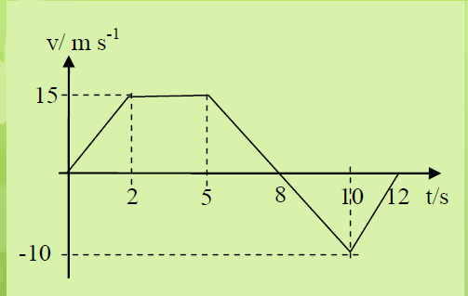
Problem solving (c) to (e)
Calculate:
(a) the acceleration for the motion in the first 2 seconds
(b) the deceleration at t = 7s
(c) total distance travelled for the whole journey
(d) the average speed
(e) Determine the shortest distance between the two towns.
(f) Sketch graphs of s-t & a-t for the whole motion
Linear motion of a car moving from town A to town B is shown in the v-t graph above.
The whole journey takes 12s.

Slide 17
solutions
Calculate:
(a) the acceleration for the motion in the first 2 seconds
=15/2= 7.5 ms⁻²
(b) the deceleration at t = 7s
=15/3= 5 ms⁻²
(c) total distance travelled for the whole journey
=82.5 + 20 = 102.5 m
(d) the average speed
=102.5/12 = 8.54 ms⁻¹
(e) Determine the shortest distance between the two towns. =82.5 - 20 = 62.5 m

Slide 18
Learning outcomes
(f) derive, from the definitions of velocity and acceleration, equations that represent uniformly accelerated motion in a straight line
(g) solve problems using equations that represent uniformly accelerated motion in a straight line, including the motion of bodies falling in a
uniform gravitational field without air resistance
(h) recall that the weight of a body is equal to the product of its mass and the acceleration of free fall
(i) describe an experiment to determine the acceleration of free fall using a falling body
(j) describe qualitatively the motion of bodies falling in a uniform gravitational field with air resistance

Slide 19
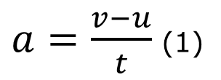

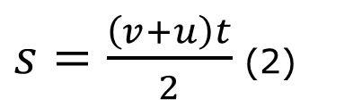


(f) Derivation of kinematics equations
$a=\frac{v−u}{t}$ (1)
$$from the definition of acceleration$$
$\overline{v}=\frac{s}{t}$ and hence
$s=\frac{\left(v+u\right)t}{2}$ (2)
$$from the definition of velocity$$
Show the remaining two kinematics equations:
s = u t + ½ at² (3)
v²= u²+ 2as (4)
Hints: substitute equation (1) into (2) to eliminate t
substitute equation (1) into (2) to eliminate v
These 4 equations are used for linear motion with constant acceleration, vertical up/down, horizontal or moving on a ramp.

Slide 20
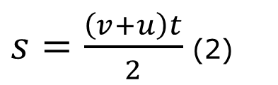
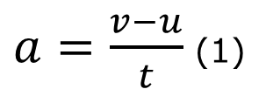
kinematics equations
$a=\frac{v−u}{t}$ (1)
Linear motion with constant acceleration
$s=\frac{\left(v+u\right)t}{2}$ (2)
s = u t + ½ at² (3)
v²= u²+ 2as (4)

Slide 21


(g) Problem solving
Example 1
A car driver travelling in his car at a steady speed of 8 m s⁻¹ sees a dog walking across the road 30 m ahead. The driver’s reaction time is 0.2 s and the brakes are capable of producing deceleration of 1.2 m s⁻².
Calculate the distance from where the car stops to where the dog is crossing assuming the driver reacts and brakes as quickly as possible.
During deceleration, distance travelled
During reaction time, the car is driven at a constant speed
S₂= (v²-u²)/2a
S₁= ut
30 m

Slide 22
Solution
During reaction time, the car is driven at a constant speed
S₁= ut = 8 x 0.2 = 1.6 m
During deceleration, distance travelled
S₂= (v²-u²)/2a = (0 – 8²)/ (2x - 1.2)=26.6667 m
Total distance travelled = 28.27 m
Thus, distance where the car stops from the dog =1.73 m

Slide 23
Example 2
A cyclist accelerates steadily from rest on 1500 m downhill stretch of road, reaching a speed of 22.0 m s⁻¹ before free wheeling to a halt 192 seconds after starting.
Sketch a speed-time graph to represent the journey
Calculate how long the cyclist takes to reach top speed
Calculate the acceleration in each part of the journey and the average speed for the whole of the journey

Slide 24

Solution
1500 m
[ans: 136, 0.162, 0.393,11]
v
22
Area of the 1st triangle=1500
Acceleration = gradient
[ans: 136, 0.162, 0.393,11]
0
136
192
t

Slide 25
(g) Acceleration of free fall, g = 9.81 m s⁻²
A free-falling object is an object which is falling under the sole influence of gravity i.e. it is moving and being acted upon only by the force of gravity
Two important characteristics:
Free-falling objects do not encounter air resistance.
All free-falling objects (on Earth) accelerate downwards at a constant rate of g = 9.81 ms⁻²

Slide 26
(h) W= mg
Hence, when a mass m is falling, its velocity increases by 9.81 m s⁻¹ in one second. The acceleration is caused by a gravitational force exerted by the Earth on the mass, which is known as its weight. The weight of the body is W= mg.

Slide 27
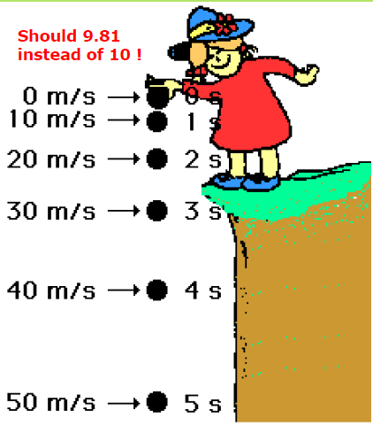

Slide 28
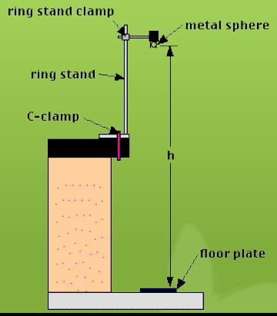
(i) determine the acceleration of free fall, g using a falling body
The time t for a ball to fall from rest through a distance h is measured and the acceleration, g due to gravity is calculated by h = ½ g t ². Measurements of t for several different values of h are carried out and a graph of h vs. t ² is plotted as shown below.

Slide 29
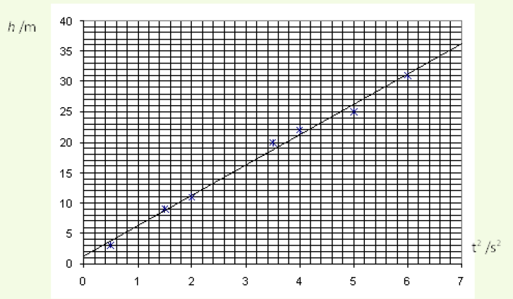

Slide 30
Calculations
Releasing from rest, u=0
h = ½ g t ²
Plotting h vs. t ²
Gradient of the graph = ½ g
Choose two points from the graphs to calculate the gradient
g = 2 x gradient = ………………………

Slide 31

Problem solving-free falling
Example 1
A mass is thrown up vertically with velocity 6 m s ⁻¹ from a cliff top.
Determine the max height the mass can rise up from where it is thrown. [1.83 ]
How long does it take to reach the max height? [0.612]
How long does it take to reach the base of the cliff which is 10 m below the cliff top?

Slide 32
Why is g = -9.81 m s ⁻² throughout the motion?
- ve
+ve
0 m s ⁻¹
Speed increases when moving down
Speed decreases when moving up
4 m s ⁻¹
-4 m s ⁻¹
5 m s ⁻¹
-5 m s ⁻¹
6 m s ⁻¹
a =dv/dt
= (-6-(-5))/dt
-ve
-6 m s ⁻¹
a =dv/dt
= (5-6)/dt
-ve
decelerating in the negative direction
Accelerating in the positive direction

Slide 33
Taking upwards as positive >> velocity
The sign of acceleration depends on the change in velocity
If a mass decelerates upwards, a –ve
If a mass accelerates downwards, a -ve
Taking upwards as negative >> velocity
The sign of acceleration depends on the change in velocity
If a mass decelerates upwards, a +ve
If a mass accelerates downwards, a +ve

Slide 34
Solution
Taking upwards movement as positive,
u= 6 m s ^{-1 ;} g = - 9.81 m s ⁻²
Determine the max height the mass can rise up from where it is thrown. [1.83 ]
How long does it take to reach the max height? [0.612]
How long does it take to reach the base of the cliff which is 10 m below the cliff top?
v²= u²+ 2as, v=0
s = (6)² /(2x9.81) = ……..
V=u+at ; v=0
t = 6/9.81 = …………..
s = u t + ½ at²
-10 = 6t- ½ 9.81 t²

Slide 35
For a falling motion,
A mass is dropped and moving downwards throughout.
Taking downwards as +ve, a= +g as the mass accelerates in the positive direction.
Displacement and velocity are also positive in values.
+ ve
4 m s ⁻¹
Speed increases when moving down
5 m s ⁻¹
6 m s ⁻¹

Slide 36
example
A mass is dropped from a tall building of 10 metres high.
(i) Determine its speed right before it hits the ground.
U=0, a = +g, s = 10
v²= u²+ 2as
v = √ 2x9.81x(10)
= ……………………
(ii) Determine its distance from the ground when t = 0.5s
U=0, a = +g, t = 2
s = u t + ½ at²
= ½ x 9.81 x 0.5²=……………..
Distance = 10 - …………. = …………………

Slide 37

(j) When a parachutist falls in air…
Identify forces acting on him
Resistive force F
Speed, viscosity, surface area
Upthrust U
ρVg
Weight W
mg

Slide 38
Terminal velocity
Start falling
Low speed
Low air resistance F
W >> F
Speed increases
air resistance increases
Constant speed
W = F + U
a = 0

Slide 39
Falling …
Without air resistance
With air resistance
V
V
t
t

Slide 40
Falling …
Without air resistance
With air resistance
a
a
t
t

Slide 41
Falling …
Without air resistance
With air resistance
s
s
t
t

Slide 42
Learning outcomes
(k) describe and explain motion due to a uniform velocity in one direction and a uniform acceleration in a perpendicular direction (projectile motion)

Slide 43
Projectile motion
A mass is thrown up with u_{o} m s⁻¹ at θ to the horizontal.
Resolve the initial velocity to get two perpendicular components.
Vertical speed decreases till zero then increasing when moving down.
Horizontal velocity remains constant as there is no air resistance and hence no net horizontal force acting on it. The only force i.e. gravitational force acts perpendicularly on it and hence it does no work to change the velocity.
u_{y}=u_{o} sinθ
u_{x}=u_{o} cosθ

Slide 44
How are displacements measured?
s_{max}
t=0
S=0
s1
s2
S=0
d1
d2
d_{max}

Slide 45
Vertical movement
Horizontal movement
v =u +at (1)
s = t (u+v)/2 (2)
s = u t + ½ at² (3)
v²= u²+ 2as (4)
where a = - g because upward movement is taken as positive and initial vertical velocity, u =u_{o} sin θ
u_{x}=u_{o} cos θ = d_{x}/t
How high?
v²= u²+ 2as
s = …………………..
Where v =0, a=-g, u = u_{o} sin θ
How long it takes to return to
the starting level?
s = u t + ½ at²
t = …………………..
Where s =0, a=-g, u = u_{o} sin θ
How far?
u_{x}=d_{x}/t
d_{x} = …………………..
Where t = total time, a=-g, u = u_{o} cos θ

Slide 46
Example 1
50 m s⁻¹
30 º
A projectile is released upwards at an angle of 30º to the horizontal level with an initial velocity of 50 m s⁻¹.
Determine the max height that the projectile achieves before falling down [31.86m]
How long does it take to reach the ground level? [5.1s]
How far can it travel from its starting point? [220.84m]

Slide 47
Solution
Determine the max height that the projectile achieves before falling down [31.86m]
How long does it take to reach the ground level? [5.1s]
How far can it travel from its starting point? [220.84m]
v²= u²+ 2as
s = (50sin 30)² /(2x9.81) = ……..
s = u t + ½ at²
0 = t (u- ½ gt)
t=0; t=2u/g = (2x50sin 30)/9.81 = …………………
d=ut
d = 50 cos 30 x 5.1 = ………………

Slide 48
Example 2
A projectile of mass 1 kg is thrown up in vacuum with 10 m s⁻¹ at 30º to the horizontal.
Which of the following statements are correct?
The horizontal acceleration is zero.
The vertical displacement increases uniformly when rising.
The resultant velocity at the maximum height is the horizontal velocity.
The KE of the projectile is zero at the max height.
The change in momentum is 10 kg m s ⁻¹

Slide 49
Projectile motion (II)
A mass is thrown up with a horizontal velocity u m s⁻¹.
An initial horizontal velocity has no vertical component, u_{y}=0
Vertical speed increases
Horizontal velocity remains constant as there is no air resistance and hence no net horizontal force acting on it. The only force i.e. gravitational force acts perpendicularly on it and hence it does no work to change the velocity.
Taking downwards as positive, s,v, and a are all positive.
u

Slide 50
Relation between vertical displacement & horizontal displacement
Vertical movement
s = u t + ½ g t² ; u=0
Horizontal movement
u= d /t
Combining two equations,
s = ½ g (d/u) ²
Since g and u are constants,
s ∝ d ²
d increases at a constant rate while
S increases at an increasing rate.
When d is doubled, s is quadruple.

Slide 51
free-falling motions
Throw up vertically/ at an angle to the horizontal then moving downwards
Drop down or moves horizontally sideway
+ve
a = -g
throughout
u=….
u=….
u=…..
u=0
a = g
+ve
+ve
a = g
s, v & a are positive

Slide 52
Drop and Bouncing
A ball is dropped and it bounces few times upon hitting the ground.
Separate downwards and upwards movements.
u=0
v = 0
+ve
+ve
a = g
a = - g
u=….

Slide 53
example
A ball is dropped at a height of 2 metres and upon hitting the ground, it bounces with 4 ms⁻¹.
Determine
the speed right before it hits the ground
the max height after the 1st bounce
the total time taken from where it is dropped to the max height after the first bounce.

Slide 54
Graphical representation
Situation 1:
A body is thrown vertically upwards, reaching a max height then falling downwards
s
v
a
t
t
t

Slide 55
Graphical representation
Situation 2:
A body is dropped, upon hitting the ground it then bounces upwards.
s
v
a
t
t
t

Slide 56

Any Questions

